Slide 1

Chapter 10 ::
Functional Languages
Programming Language Pragmatics
Michael L. Scott
Copyright © 2009 Elsevier

Slide 2
Historical Origins
The imperative and functional models grew out of work undertaken Alan Turing, Alonzo Church, Stephen Kleene, Emil Post, etc. ~1930s
  different formalizations of the notion of an algorithm, or effective procedure, based on automata, symbolic manipulation, recursive function definitions, and combinatorics
These results led Church to conjecture that any intuitively appealing model of computing would be equally powerful as well
  this conjecture is known as Church’s thesis
Copyright © 2009 Elsevier

Slide 3
Historical Origins
Turing’s model of computing was the Turing machine a sort of pushdown automaton using an unbounded storage “tape”
  the Turing machine computes in an imperative way, by changing the values in cells of its tape – like variables just as a high level imperative program computes by changing the values of variables
Copyright © 2009 Elsevier

Slide 4
Historical Origins
Church’s model of computing is called the lambda calculus
  based on the notion of parameterized expressions (with each parameter introduced by an occurrence of the letter λ—hence the notation’s name.
  Lambda calculus was the inspiration for functional programming
  one uses it to compute by substituting parameters into expressions, just as one computes in a high level functional program by passing arguments to functions
Copyright © 2009 Elsevier

Slide 5
Historical Origins
Mathematicians established a distinction between
  constructive proof (one that shows how to obtain a mathematical object with some desired property)
  nonconstructive proof (one that merely shows that such an object must exist, e.g., by contradiction)
Logic programming is tied to the notion of constructive proofs, but at a more abstract level:
  the logic programmer writes a set of axioms that allow the computer to discover a constructive proof for each particular set of inputs
Copyright © 2009 Elsevier

Slide 6
Functional Programming Concepts
Functional languages such as Lisp, Scheme, FP, ML, Miranda, and Haskell are an attempt to realize Church's lambda calculus in practical form as a programming language
The key idea: do everything by composing functions
  no mutable state
  no side effects
Copyright © 2009 Elsevier

Slide 7
Functional Programming Concepts
Necessary features, many of which are missing in some imperative languages
  1st class and high-order functions
  serious polymorphism
  powerful list facilities
  structured function returns
  fully general aggregates
  garbage collection
Copyright © 2009 Elsevier

Slide 8
Functional Programming Concepts
So how do you get anything done in a functional language?
  Recursion (especially tail recursion) takes the place of iteration
  In general, you can get the effect of a series of assignments
  x := 0 ...
  x := expr1 ...
  x := expr2 ...
  from f3(f2(f1(0))), where each f expects the value of x as an argument, f1 returns expr1, and f2 returns expr2
Copyright © 2009 Elsevier

Slide 9
Functional Programming Concepts
Recursion even does a nifty job of replacing looping
x := 0; i := 1; j := 100;
while i < j do
x := x + i*j; i := i + 1;
j := j - 1
end while
return x
becomes f(0,1,100), where
f(x,i,j) == if i < j then
f (x+i*j, i+1, j-1) else x
Copyright © 2009 Elsevier

Slide 10
Functional Programming Concepts
Thinking about recursion as a direct, mechanical replacement for iteration, however, is the wrong way to look at things
  One has to get used to thinking in a recursive style
Even more important than recursion is the notion of higher-order functions
  Take a function as argument, or return a function as a result
  Great for building things
Copyright © 2009 Elsevier

Slide 11
Functional Programming Concepts
Lisp also has (these are not necessary present in other functional languages)
  homo-iconography
  self-definition
  read-evaluate-print
Variants of LISP
  Pure (original) Lisp
  Interlisp, MacLisp, Emacs Lisp
  Common Lisp
  Scheme
Copyright © 2009 Elsevier

Slide 12
Functional Programming Concepts
Pure Lisp is purely functional; all other Lisps have imperative features
All early Lisps dynamically scoped
  Not clear whether this was deliberate or if it happened by accident
Scheme and Common Lisp statically scoped
  Common Lisp provides dynamic scope as an option for explicitly-declared special functions
  Common Lisp now THE standard Lisp
    Very big; complicated (The Ada of functional programming)
Copyright © 2009 Elsevier

Slide 13
Functional Programming Concepts
Scheme is a particularly elegant Lisp
Other functional languages
  ML
  Miranda
  Haskell
  FP
Haskell is the leading language for research in functional programming
Copyright © 2009 Elsevier

Slide 14
A Review/Overview of Scheme
As mentioned, Scheme is a particularly elegant Lisp
  Interpreter runs a read-eval-print loop
  Things typed into the interpreter are evaluated (recursively) once
  Anything in parentheses is a function call (unless quoted)
  Parentheses are NOT just grouping, as they are in Algol-family languages
    Adding a level of parentheses changes meaning
Copyright © 2009 Elsevier

Slide 15
A Review/Overview of Scheme
As mentioned earlier, Scheme is a particularly elegant Lisp
  Interpreter runs a read-eval-print loop
  Things typed into the interpreter are evaluated (recursively) once
  Anything in parentheses is a function call (unless quoted)
  Parentheses are NOT just grouping, as they are in Algol-family languages
    Adding a level of parentheses changes meaning
    (+ 3 4) ⇒ 7
    ((+ 3 4))) ⇒ error
    (the ' ⇒' arrow means 'evaluates to‘)
Copyright © 2009 Elsevier

Slide 16
A Review/Overview of Scheme
Scheme:
  Boolean values #t and #f
  Numbers
  Lambda expressions
  Quoting
  (+ 3 4) ⇒ 7
  (quote (+ 3 4)) ⇒ (+ 3 4)
  '(+ 3 4) ⇒ (+ 3 4)
  Mechanisms for creating new scopes
  (let ((square (lambda (x) (* x x))) (plus +))
  (sqrt (plus (square a) (square b))))
  let*
  letrec
Copyright © 2009 Elsevier

Slide 17
A Review/Overview of Scheme
Scheme:
  Conditional expressions
  (if (< 2 3) 4 5) ⇒ 4
  (cond
  ((< 3 2) 1)
  ((< 4 3) 2)
  (else 3)) ⇒ 3
  Imperative stuff
    assignments
    sequencing (begin)
    iteration
    I/O (read, display)
Copyright © 2009 Elsevier

Slide 18
A Review/Overview of Scheme
Scheme standard functions (this is not a complete list):
  arithmetic
  boolean operators
  equivalence
  list operators
  symbol?
  number?
  complex?
  real?
  rational?
  integer?
Copyright © 2009 Elsevier

Slide 19
A Review/Overview of Scheme
Example program - Simulation of DFA
We'll invoke the program by calling a function called 'simulate', passing it a DFA description and an input string
  The automaton description is a list of three items:
    start state
    the transition function
    the set of final states
  The transition function is a list of pairs
    the first element of each pair is a pair, whose first element is a state and whose second element in an input symbol
    if the current state and next input symbol match the
    first element of a pair, then the finite automaton enters
    the state given by the second element of the pair
Copyright © 2009 Elsevier

Slide 20
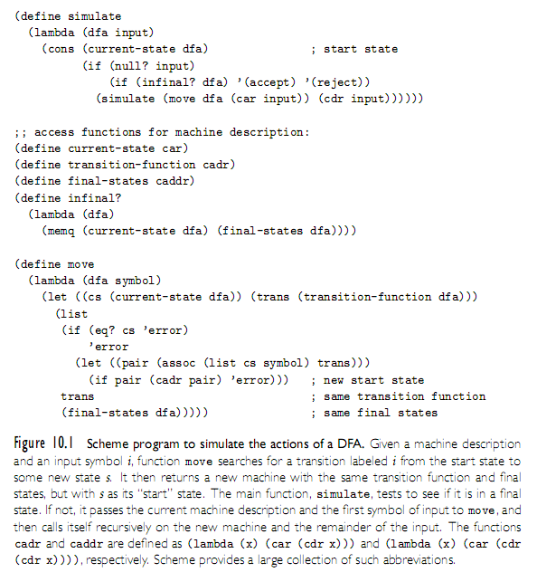
A Review/Overview of Scheme
Example program - Simulation of DFA
Copyright © 2009 Elsevier

Slide 21
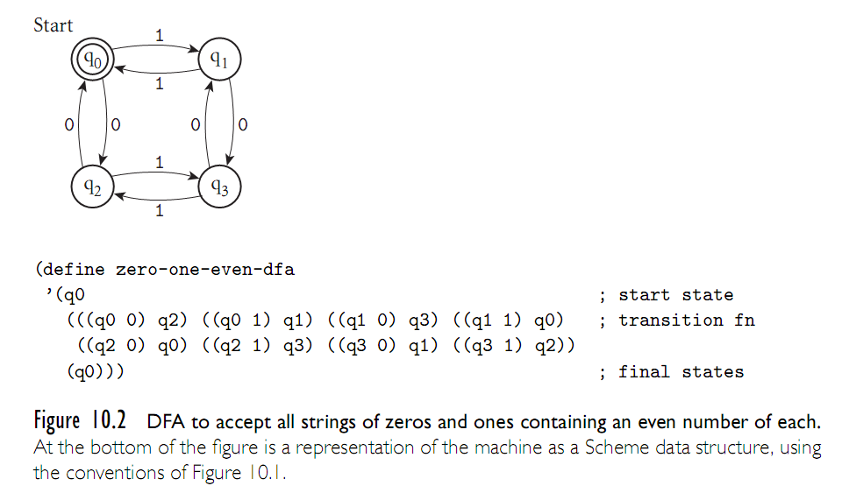
A Review/Overview of Scheme
Example program - Simulation of DFA
Copyright © 2009 Elsevier

Slide 22
Evaluation Order Revisited
Applicative order
  what you're used to in imperative languages
  usually faster
Normal order
  like call-by-name: don't evaluate arg until you need it
  sometimes faster
  terminates if anything will (Church-Rosser theorem)
Copyright © 2009 Elsevier

Slide 23
Evaluation Order Revisited
In Scheme
  functions use applicative order defined with lambda
  special forms (aka macros) use normal order defined with syntax-rules
A strict language requires all arguments to be well-defined, so applicative order can be used
A non-strict language does not require all arguments to be well-defined; it requires normal-order evaluation
Copyright © 2009 Elsevier

Slide 24
Evaluation Order Revisited
Lazy evaluation gives the best of both worlds
But not good in the presence of side effects.
  delay and force in Scheme
  delay creates a "promise"
Copyright © 2009 Elsevier

Slide 25
High-Order Functions
Higher-order functions
  Take a function as argument, or return a function as a result
  Great for building things
  Currying (after Haskell Curry, the same guy Haskell is named after)
    For details see Lambda calculus on CD
    ML, Miranda, and Haskell have especially nice syntax for curried functions
Copyright © 2009 Elsevier

Slide 26
Functional Programming in Perspective
Advantages of functional languages
  lack of side effects makes programs easier to understand
  lack of explicit evaluation order (in some languages) offers possibility of parallel evaluation (e.g. MultiLisp)
  lack of side effects and explicit evaluation order simplifies some things for a compiler (provided you don't blow it in other ways)
  programs are often surprisingly short
  language can be extremely small and yet powerful
Copyright © 2009 Elsevier

Slide 27
Functional Programming in Perspective
Problems
  difficult (but not impossible!) to implement efficiently on von Neumann machines
    lots of copying of data through parameters
    (apparent) need to create a whole new array in order to change one element
    heavy use of pointers (space/time and locality problem)
    frequent procedure calls
    heavy space use for recursion
    requires garbage collection
    requires a different mode of thinking by the programmer
    difficult to integrate I/O into purely functional model
Copyright © 2009 Elsevier

